Slide 1
Advertisement Click propensity model & heuristic investment strategy case study
By Farshad Rastgouy

Slide 2
objectives
Cover a high level overview of methodology
Discuss model insights
Present heuristic Investment strategy

Slide 3
methodology
First, we trained a model that can predict whether a user would click on an ad based on the number of impressions on each site
Opened up that model to determine what fields are contributing the most to it
Determined the profit (or ROI) of each site based on
  The likelihood of how many clicks we would get from our predictions
  Our total impressions
  £8.42/click
  £2.85/1000 impressions
Combined the ROI of each site with the model feature importance to formulate a priority score
Allocate a budget based on each site’s contribution to the total priority score of all sites

Slide 4
methodology
Created 5 groups of similar site functions and uses
Hierarchy goes:
Sites
Category
Groups

Slide 5
methodology
Social Engagement : Help you connect
  Social Bookmarking,
  Social Networking
Media Sharing : Sharing platform
  Photo Sharing
  Video Sharing
Aggregations and Analytics : Measure social content from across the web
  Social Media Aggregators
  User Generated Content Aggregator
  Social Media Measurement

Slide 6
methodology
Information : Publishers
  Blogs
  News
  Opinion Sites
Utilities and Tools : “Back-Office” tools
  Content/CMS Impressions
  Documents
  Foursquare
  Conduit
  Feedburner

Slide 7
model
We took data telling us how many ad views a user saw on a given day on a list of 81 websites over a 2 week period
We generated an additional 99 fields that we thought could be useful
Removed fields that would add noise, or do not show a relationship with click rate
Incorporated fields that accounted for fields with non-linear relationships
Removed fields too closely correlated, by taking combinations of fields most similar to each other, and removing the field with the weakest relationship to a click

Slide 8
model
Tried different models (logistic regression and Light GBM)
Fine tuned and optimised them in a variety of ways
Assessed the results with precision, recall, f1-score, MCC and profit/row
Assessed for over-fitting with nested cross-validation and by applying our model to the training set
Selected the top performing model, based on our metrics
  Emphasis on precision (focused strategy), f1-score (overall performance), and profit/row
Threshold tuned for the probability threshold to register a click prediction
  Emphasis on precision (focused strategy), f1-score (overall performance), and profit/row

Slide 9
model
Retrained the model on all data
  (a hold out sample was used to assess the model during training)
Applied the model with the probability threshold
Made click predictions on the prediction dataset

Slide 10
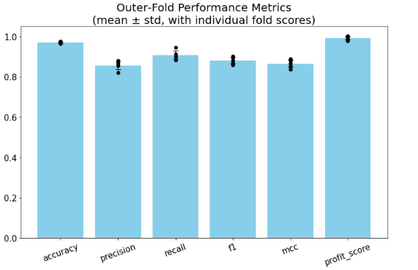
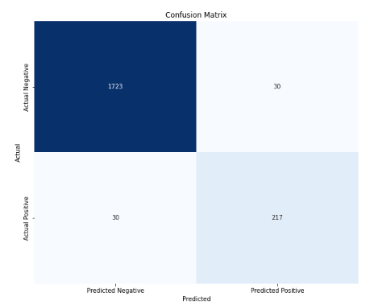
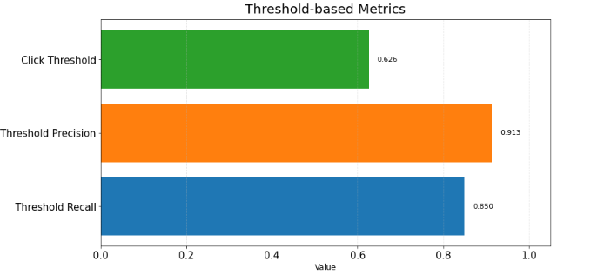
Model selection
Logistic Regression
  Normalised values
  Regularisation strength (C) : 3.5
  Penalty: : L2
  Class Weight : no weighting
  Solver : Liblinear
  Threshold Profit per user, per day : 85.7p

Slide 11
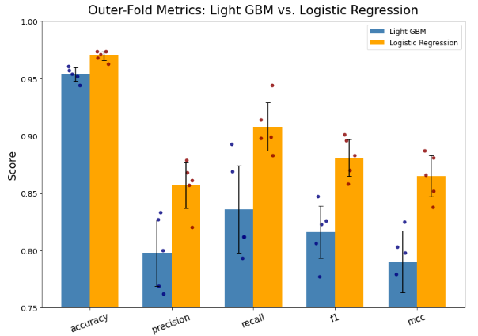
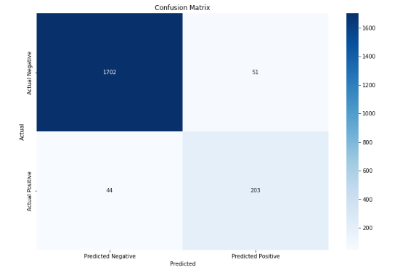
Model selection
Logistic regression beat Light GBM on precision and recall
  Light GBM registers 70% more false positives
  Light GBM registers 47% more false negatives

Slide 12
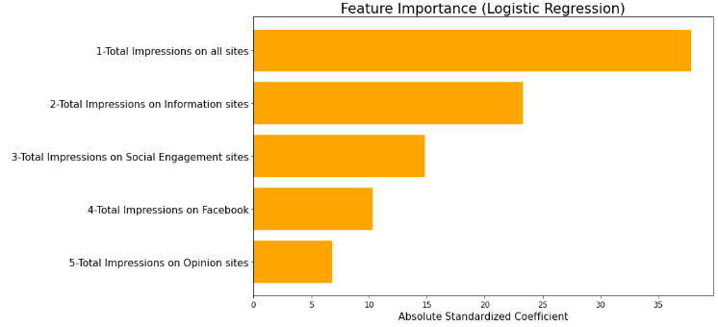
Model insights
94 fields used
5 top features in the feature importance:

Slide 13
Heuristic investment strategy inferred from model
Took fields with a positive coefficient
Dropped fields that were not to do with total impressions on sites
Took the standardised coefficients of these fields
Computed the %age of each field’s standardised coefficient for the sum of all fields’ standardised coefficient
Summed the probability of every row with at least 1 impression for each of these fields to give total clicks across all rows
Revenue = Likely total clicks * 8.42
Cost = Total Impressions across all rows * (2.85/1000)
ROI = (Revenue – Cost)/Cost
Priority Score = Standardised Coefficient * ROI
Budget % = Priority Score / Sum Priority Score of all fields

Slide 14
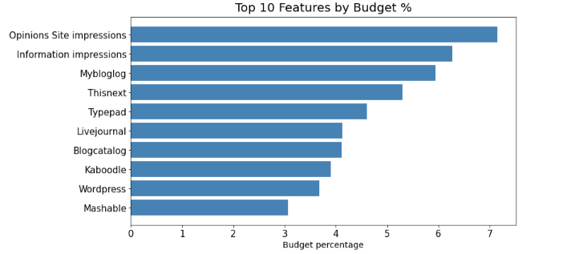
Heuristic investment strategy inferred from model
You will notice overlap between these sites
  Wordpress falls under “Information”
  If a site falls under a group or category, we may expend part of the budget for the group or category on that site, on top of the designated budget for that site

Slide 15
Heuristic investment strategy inferred from model
Spend :
  7.2% of budget on Opinion Sites
  6.3% on Blogs, News and again on Opinion Sites again (should you choose)
  5.9% on just Mybloglog (Blog site)
  5.3% on Thisnext (Opinion site)
  4.6% on Typepad (Blog site)
  4.1% on Livejournal (Blog site)
  4.1% on Blogcatalog (Blog site)
  3.9% on Kaboodle (Opinion site)
  3.7% on Wordpress (Blog site)
  3.1% on Mashable (Blog site)
  Etc..

Slide 16
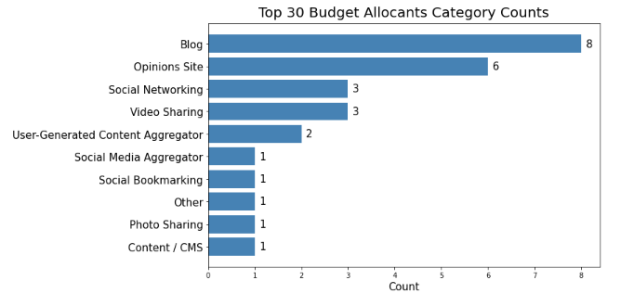
Heuristic investment strategy inferred from model
The top 30 Budget allocates make up 83% of the budget
Dominated by Blogs and Opinion sites (14 out of 30)
Information (publishers) group should be the focus

Slide 17
Heuristic investment strategy inferred from model
Avoid in the way they have been used in the 2 week experiment:
  Facebook
  Utilities and tools
  Stumbleupon
Full list of budget allocation with 71 budget allocants available in the code

Slide 18
Assumption
Revenue per click (£8.42) is constant and uniform
Cost of Media is constant and uniform (£2.85 per 1000 impressions)
Static user behaviour
  Experiment was carried over a 2 week period – not accounting for seasonality
All sites recommended have the capacity for additional impressions
  No supply cap
Independent site effect
  Recommendations focuses especially on certain types of sites – no cannibalisation
Temporal independent predictions
  No data on when the impressions were seen (day of week, time, etc)

Slide 19
Thank you

